Slide 1
A Visit to the States Chamber
Lesson 5
Learning Objectives:
To understand the importance of the Mace and symbols in the States Assembly.

Slide 2
What are 5 things you’ve learnt about the States Assembly so far? Write them down!

Slide 3
Roles
Usher –
Dean –
Greffier –
Proposer –
Seconder –

Slide 4
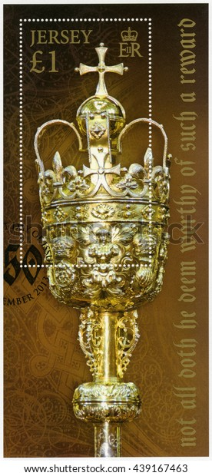
What does this make you think of? What do you think it represents?

Slide 5
The Royal Mace
Gifted by King Charles II in 1663 as a thank you gift
Carried in front of the Bailiff
Symbol of our ancient links with the Crown
Represents authority in the States Chamber

Slide 6
Symbols
The Royal Mace is decorated with many symbols.
From Christian crosses to Fleur de Lys, to cherubs and crowns, the Mace was decorated to show what was important to the people of Jersey.
What do you think is important about Jersey?

Slide 7
Design your own Mace!
Now you’ve read about the Royal Mace and thought about what is importance about Jersey, you are going to design your own!

