Slide 1
A Visit to the States Chamber
Lesson 3
Learning Objectives:
To understand the format of a States Meeting and a formal debate.

Slide 2
Recap Quiz – What can you remember?
How many States Members are there in the States Assembly?
What group do ‘Executive Members’ make up in the Assembly?
What is the name for the members that make up the Scrutiny Panels?
How often are general elections held?
When will the next general election be held in Jersey?

Slide 3
Recap Quiz - Answers
How many States Members are there in the States Assembly? 49
What group do ‘Executive Members’ make up in the Assembly? Council of Ministers
What is the name for the members that make up the Scrutiny Panels? Non-Executive Members
How often are general elections held? Once every 4 years
When will the next general election be held in Jersey? 2026

Slide 4
Homework Recap
Having read about and researched Scrutiny, how many panels are there?
Go for Gold!:
What are the names of the Scrutiny panels?
Which States Members sit on each of them?
Create a short poster / PPT presentation that shows the setup of Scrutiny

Slide 5
Homework Recap - Answers
Having read about and researched Scrutiny, how many panels are there? 5 panels + Public Accounts Committee
Go for Gold!:
What are the names of the Scrutiny panels? Corporate Services - Economic & International Affairs - Children, Education & Home Affairs – Environment, Housing & Infrastructure – Health & Social Security
Which States Members sit on each of them? See links for details:
Scrutiny Panel (gov.je) Scrutiny Panel (gov.je) Scrutiny Panel (gov.je) Scrutiny Panel (gov.je) Scrutiny Panel (gov.je)

Slide 6
Think, Pair, Share
What is a debate?

Slide 7
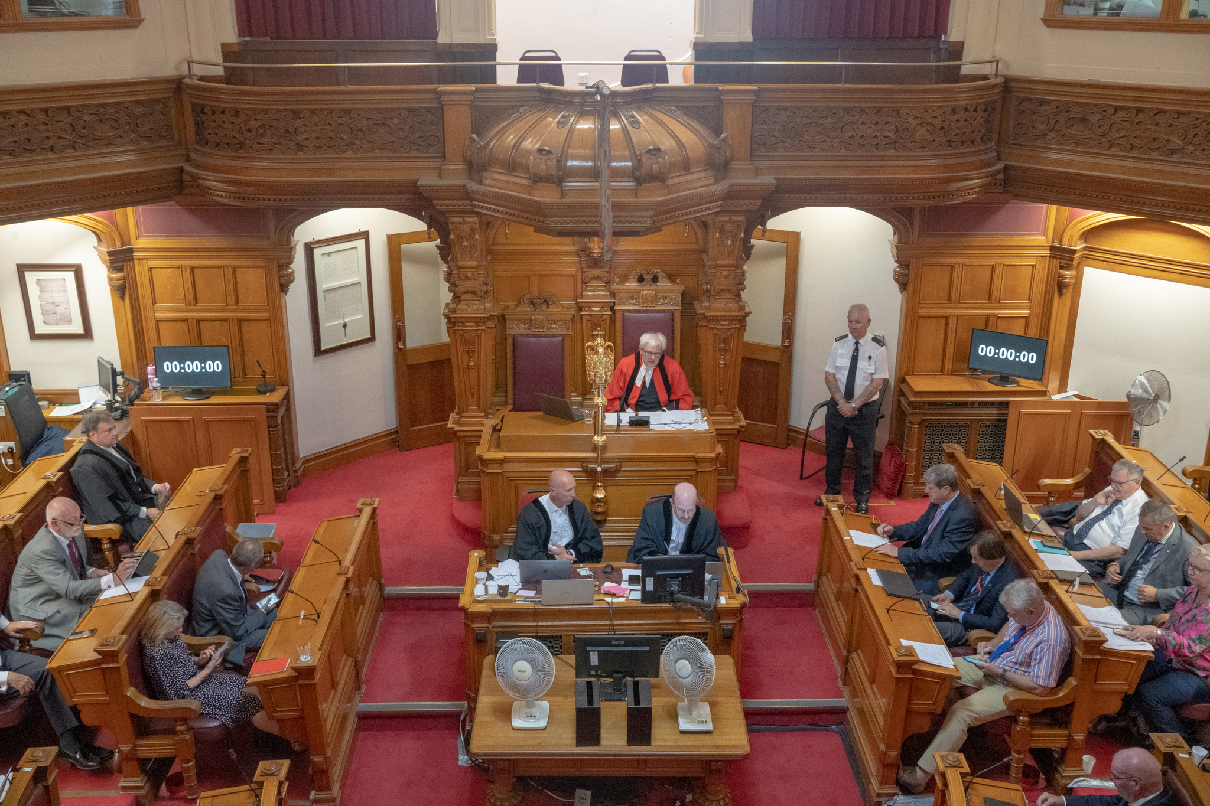
What do all of these images have in common?

Slide 8
Debates
A formal discussion on a particular matter where opposing arguments are put forward and which usually ends with a vote.

Slide 9
Setup of a debate
Proposer
The person who puts forward
a proposal for debate.
Seconder
The person who shows immediate support for the proposal.
Chairperson
The person who presides over a debate and ensures it runs smoothly.

Slide 10
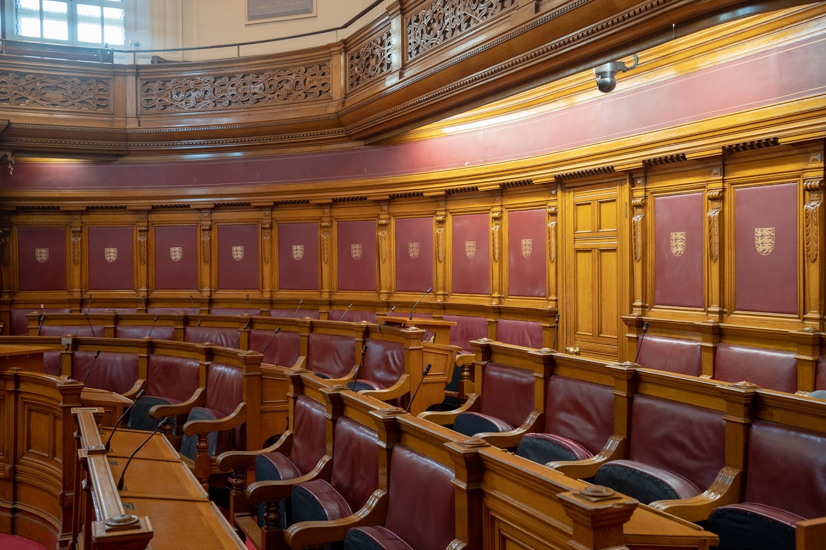
Debates in the States Assembly
Debates in the States Assembly are very similar to formal debates.
You will be holding a debate of your own when you visit the Chamber!

Slide 11
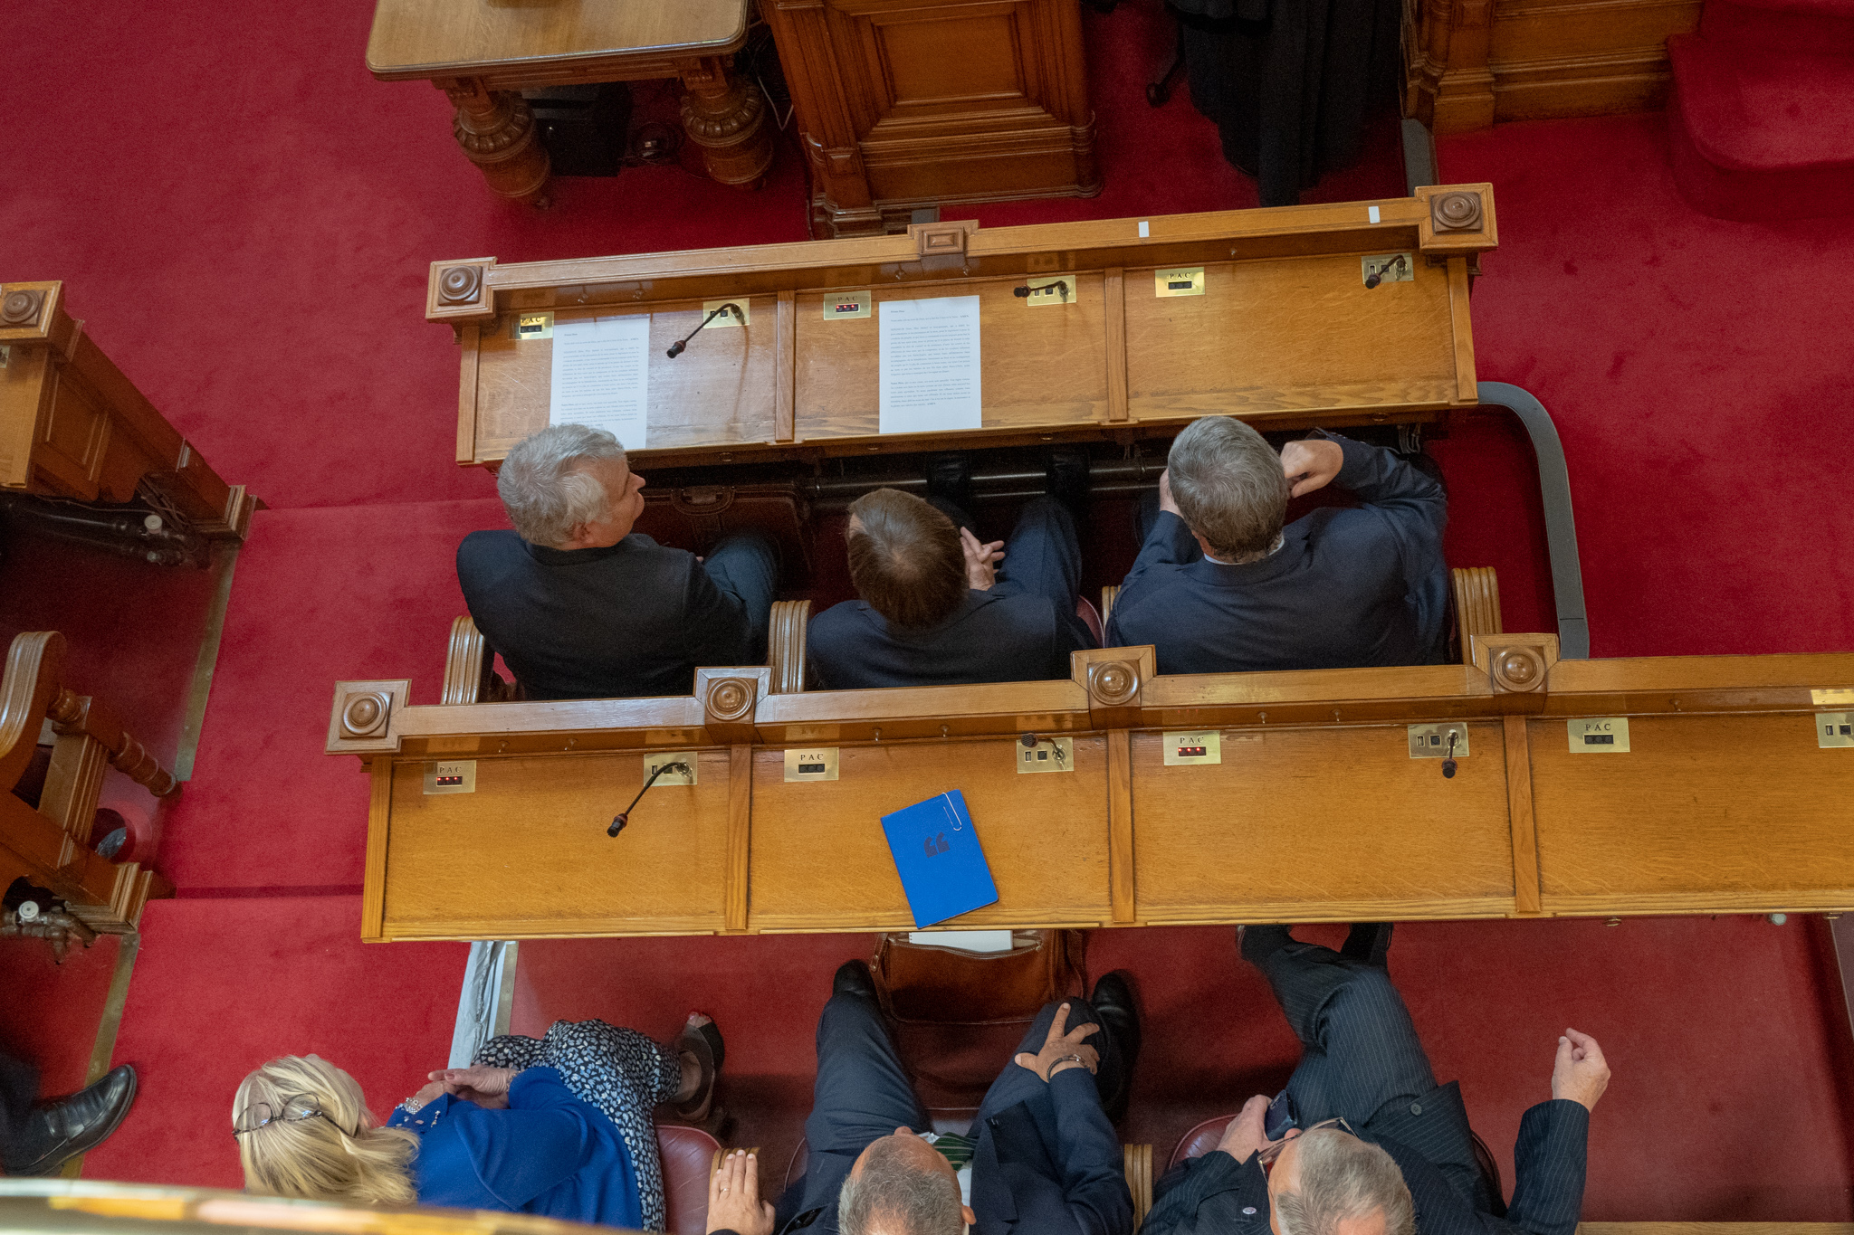
Debates in the States Assembly
Any States Member can propose or second an idea for debate in Jersey’s States Assembly.

Slide 12
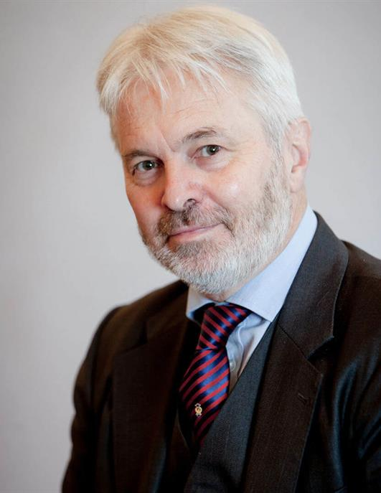
Debates in the States Assembly
However, the chairperson of debates in the States Assembly is the Bailiff, Sir Timothy Le Cocq. He is known as the President of the States.

Slide 13
Order of States Meetings
Now you’ve read the booklet explaining the roles, cut out the events of a States Meeting and put them in the order you think the events happen.
Members take turns to speak on proposition | Lord’s Prayer | Proposer introduces proposition
Usher announces Bailiff | Seconder speaks about proposition | Roll Call
Proposer responds at the end of the debate | A vote is held | Greffier reads out Order Paper

Slide 14
Order of States Meetings
Usher announces Bailiff
Roll Call
Lord’s Prayer
Greffier reads out Order Paper
Proposer introduces proposition
Seconders speaks about proposition
Members take turns to speak on proposition
Proposer responds at the end of the debate
A vote is held

Slide 15
Roles in your debate
There are 5 roles the class needs to fill for the debate in the States Chamber:
Proposer
Seconder
Dean
Greffier
Usher
Would you like to be one of these?

